Slide 1
Information on VOLUNTARY RELOCATION procedure

Slide 2
VOLUNTARY RELOCATION
is a procedure that allows the voluntary transfer of applicants for international protection rescued at sea from one Member State (in your case, Italy) to other Member States.
The transfer does not mean you will automatically be granted international protection – the identified Member State will evaluate your application and decide whether to grant you protection or not.

Slide 3
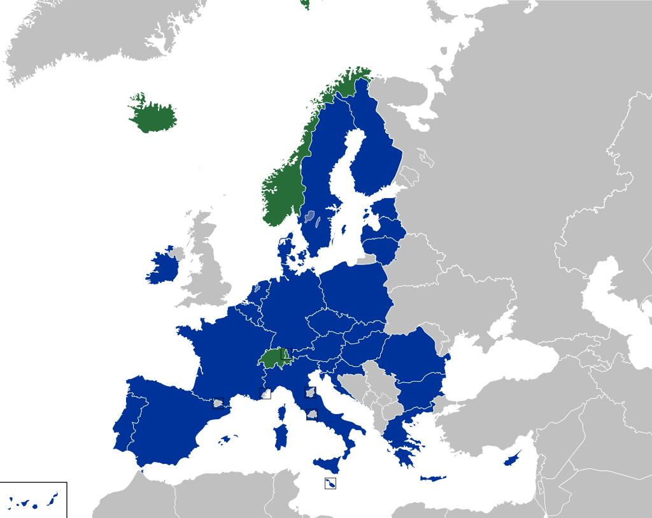

Slide 4
During registration of your request for international protection:
The registration officer will ask some additional questions to find out if you have any family members in the European Union or have linguistic, cultural or social ties with one of the Member States.

Slide 5
You will not be able to choose the Member State of relocation.
The information you share during registration about any family members living in European Union or any linguistic, cultural or social ties is very important as it can help with identifying the Member State that would proceed with the examination of your request for international protection.

Slide 6
Based on the information you provide during registration and the availability of Member States, you might be included in a list of applicants proposed to a Member State.
Once the proposed list has been accepted, representatives of the Member State can organise additional interviews with you in order to better evaluate the possibility of proceeding with your transfer for the examination of your application for international protection.

Slide 7
Following the additional interviews with a Member State (if applicable), if they confirm the possibility for you to be relocated, the authorities will ask for your final consent to be transferred to the identified Member State.
If you consent, you will be transferred to identified Member State, with the support of IOM free of charge.
Upon arrival to the identified Member State, the determining authority of that country will evaluate your application for international protection to decide whether to grant you protection or not.

Slide 8
In case you are not included amongst those to be transferred or do not accept to be transferred, your request for international protection will be examined in Italy by the competent determining authority (the local Territorial Commission), which will decided whether to grant you protection or not.

Slide 9
If you leave the reception centre without justification, you might lose the opportunity to participate in the voluntary relocation procedure and the examination of your application for international protection might be suspended.

Slide 10
If you travel independently to another Member State, you are at risk of irregular stay. If you apply for international protection in another Member State, you can be sent back to Italy.
This is known as the ‘Dublin procedure’.

Slide 11
your rights and duties during the procedure

Slide 12
These procedures are standard for everyone.
It is your duty and in your best interest to cooperate with the authorities, telling the truth and sharing all the relevant documents and information.

Slide 13
please let the officials know if you have any vulnerability and specific needs such as:
You don’t feel well,
you are injured or need urgent medical assistance
You have any disability or other health issue
You are pregnant
You don’t currently feel safe

Slide 14
These procedures are standard for everyone.
An interpreter will be available, if necessary.
Tell the authorities if you do not understand the official or the interpreter.

Slide 15
You have the right to be informed. The officer who will register your application will inform you about your rights and duties and about each step of the procedure.
These procedures are standard for everyone.

Slide 16
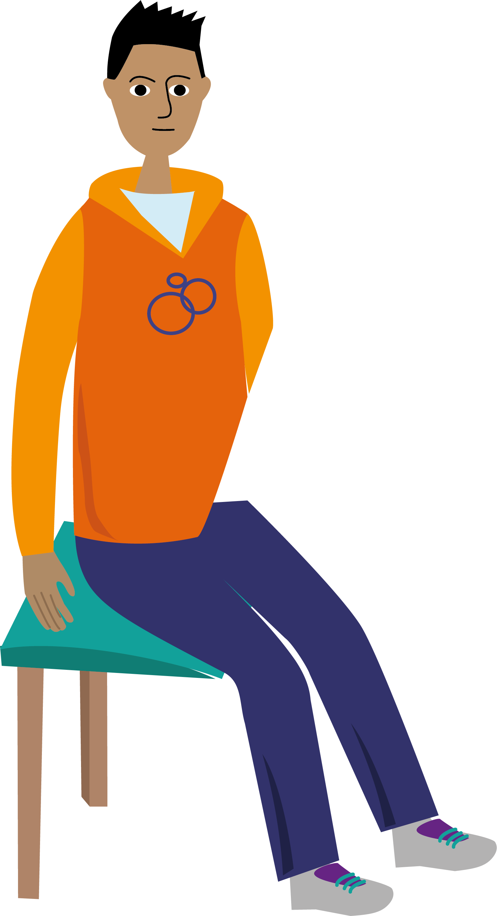
Everything you declare within the procedure is protected by the principle of confidentiality: the information shared cannot be disclosed or transmitted to the authorities of your country of origin.
These procedures are standard for everyone.

